Slide 1
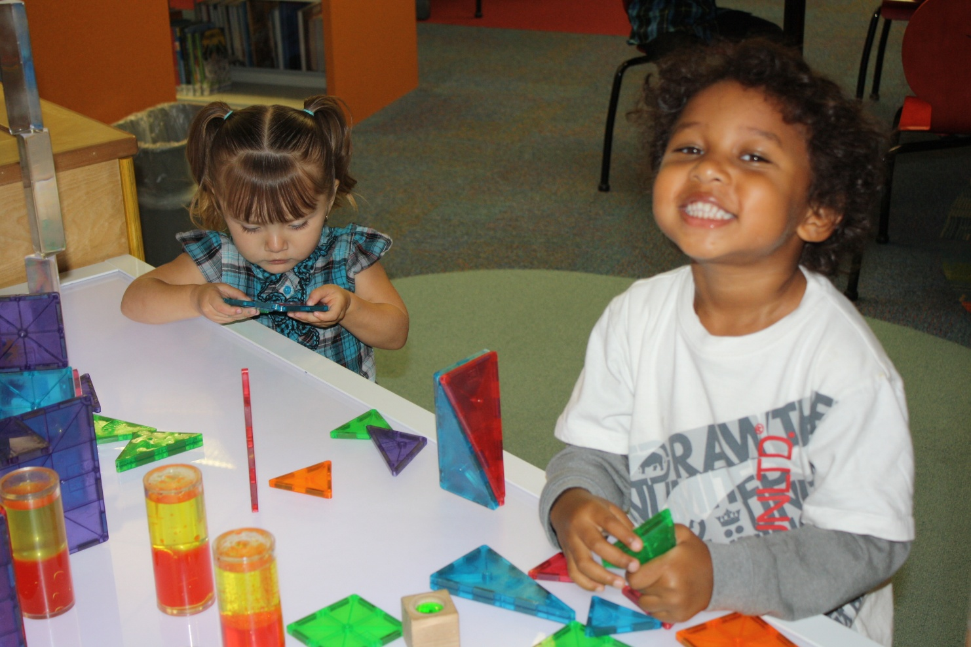

EmPOWERing Access Project
Light Tables
Wess Garcia, Library Director
CITY OF RANCHO CUCAMONGA
From Seed Funding to Flourishing Forest
Rancho Cucamonga Public Library

Slide 2
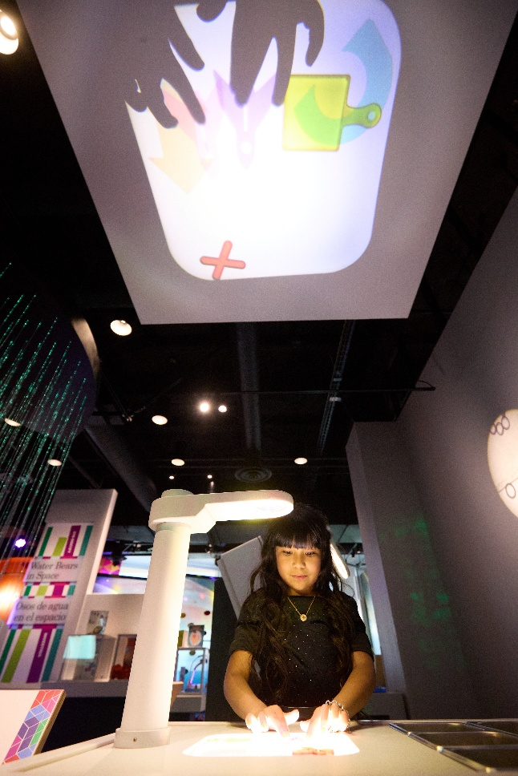
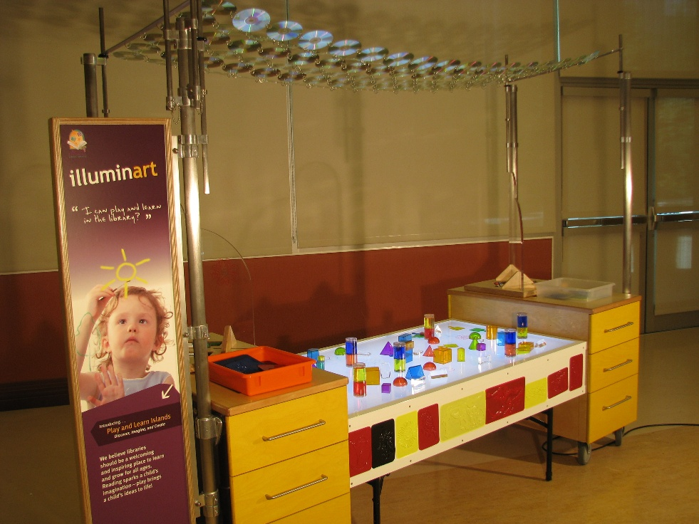


CITY OF RANCHO CUCAMONGA

Slide 3
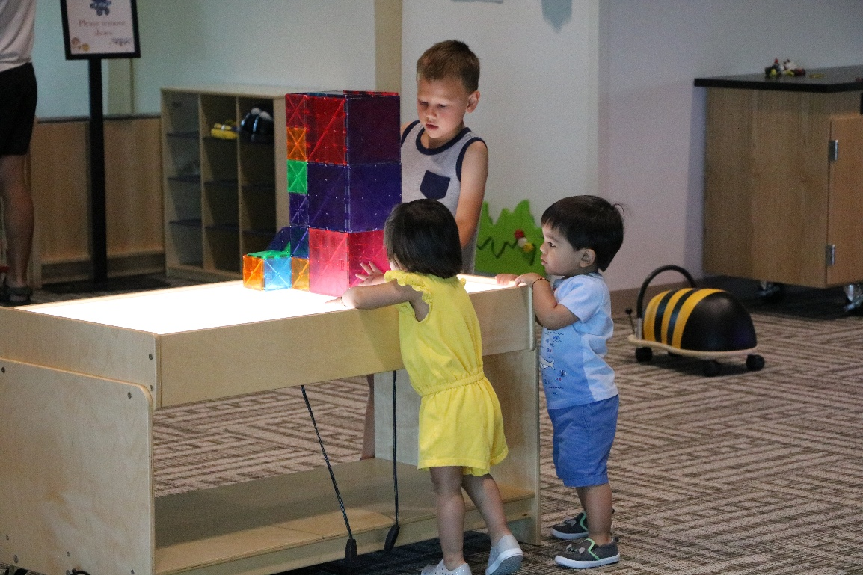
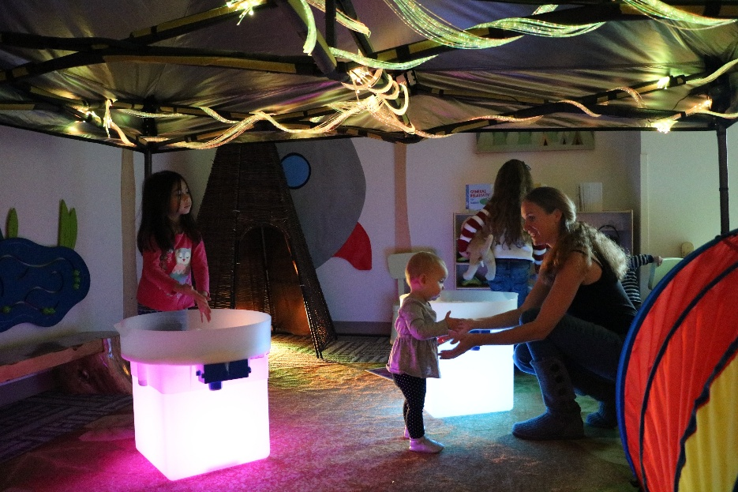

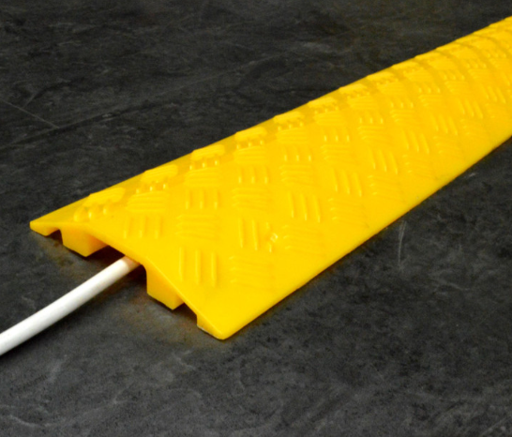

Slide 4
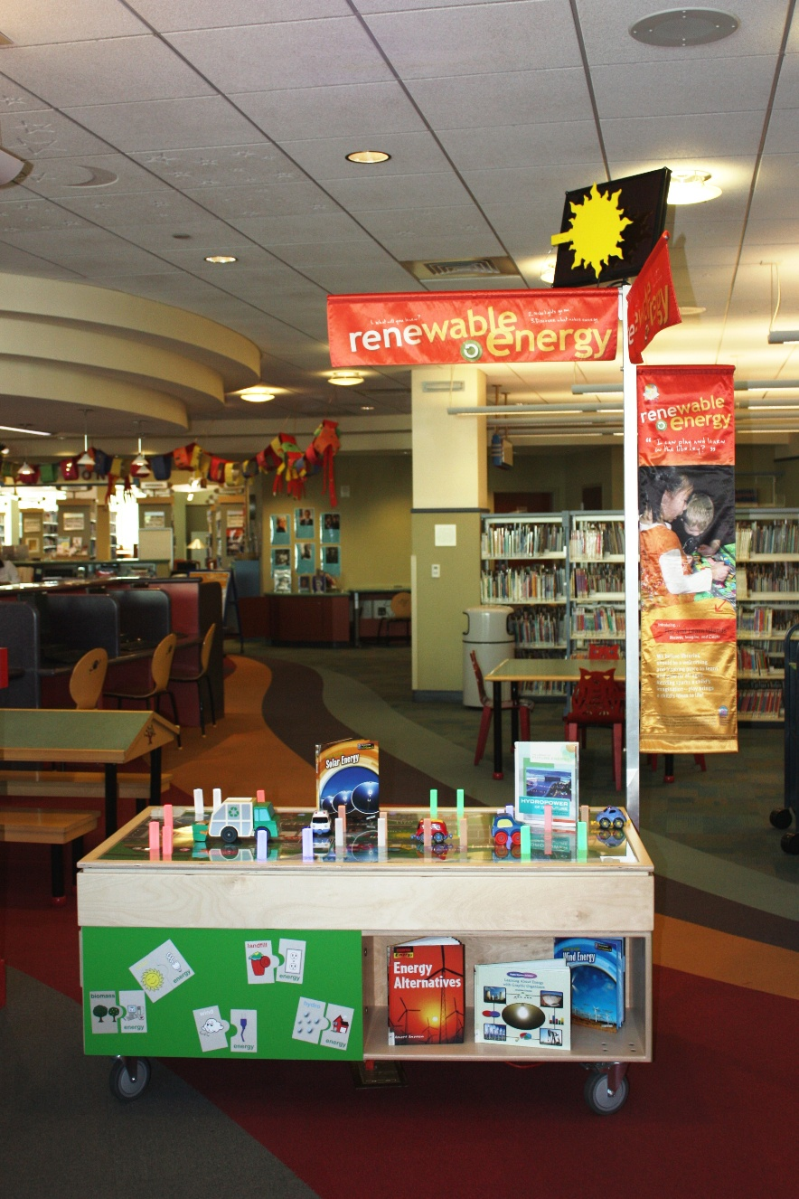
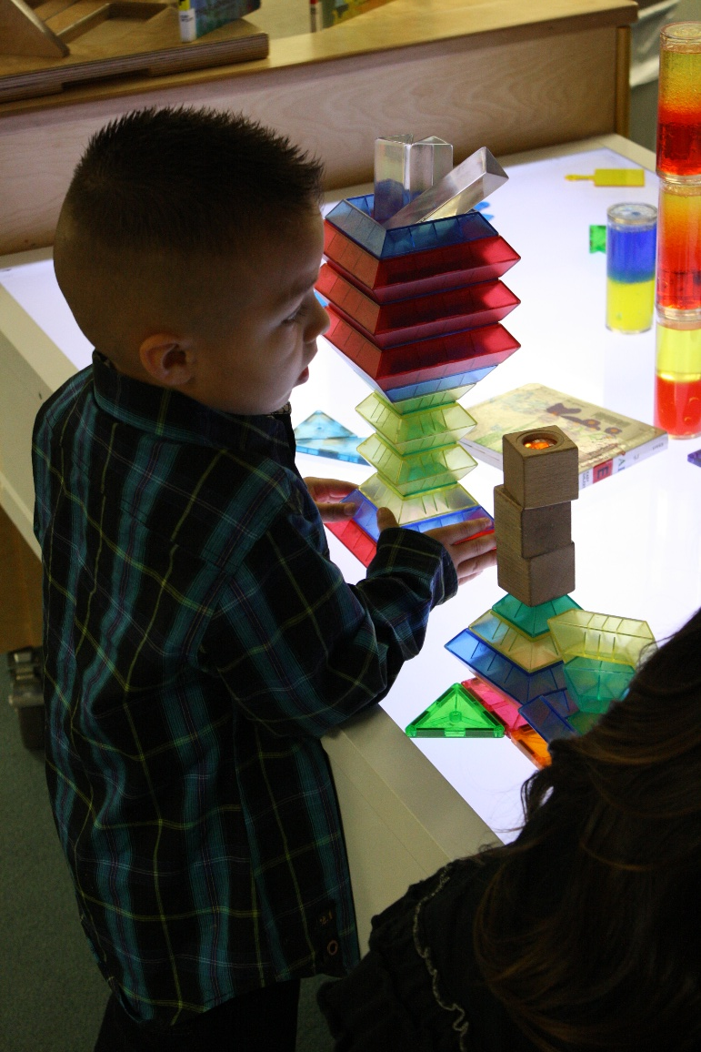

Slide 5
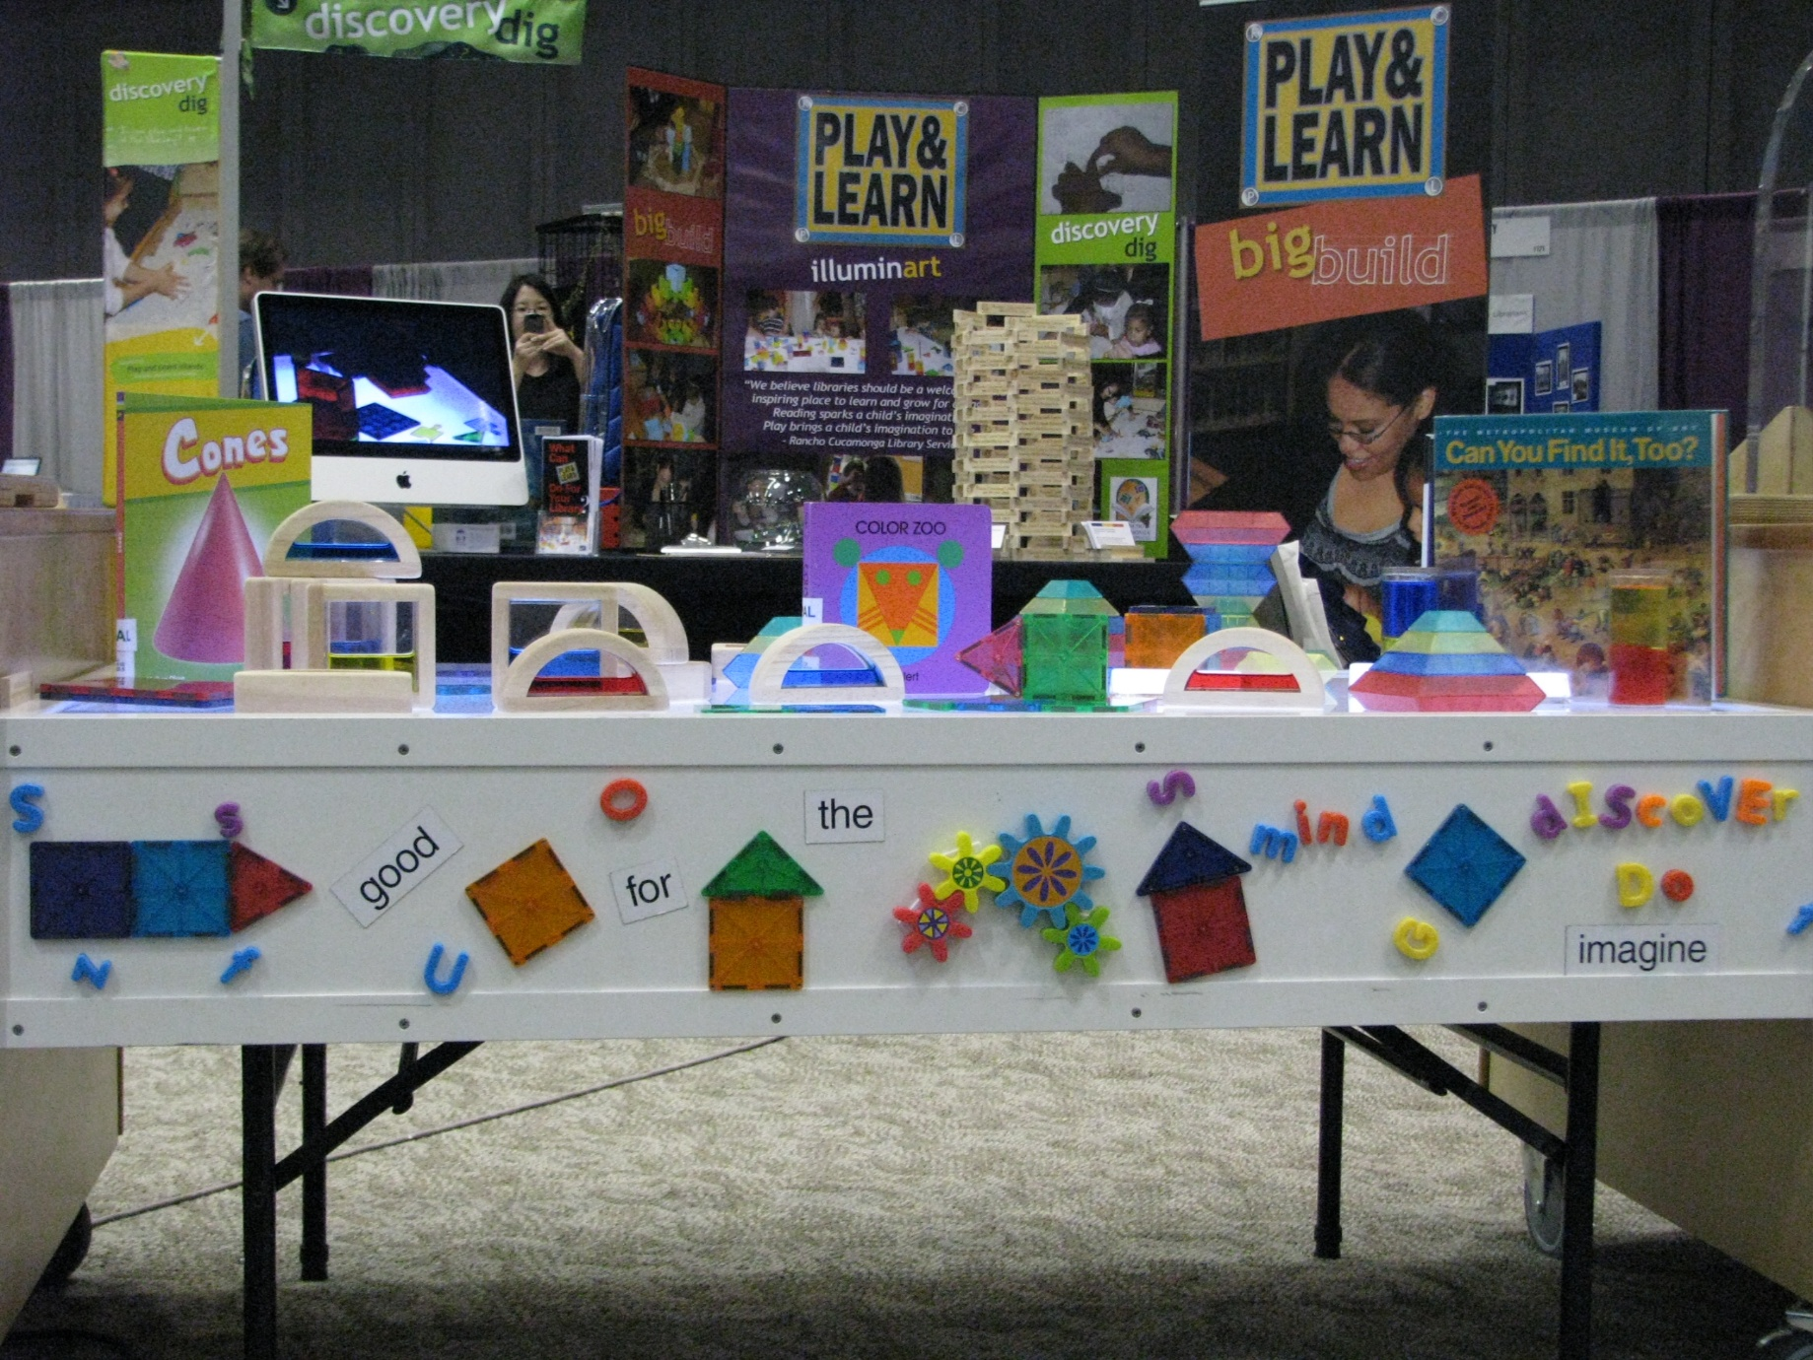
CITY OF RANCHO CUCAMONGA

Slide 6
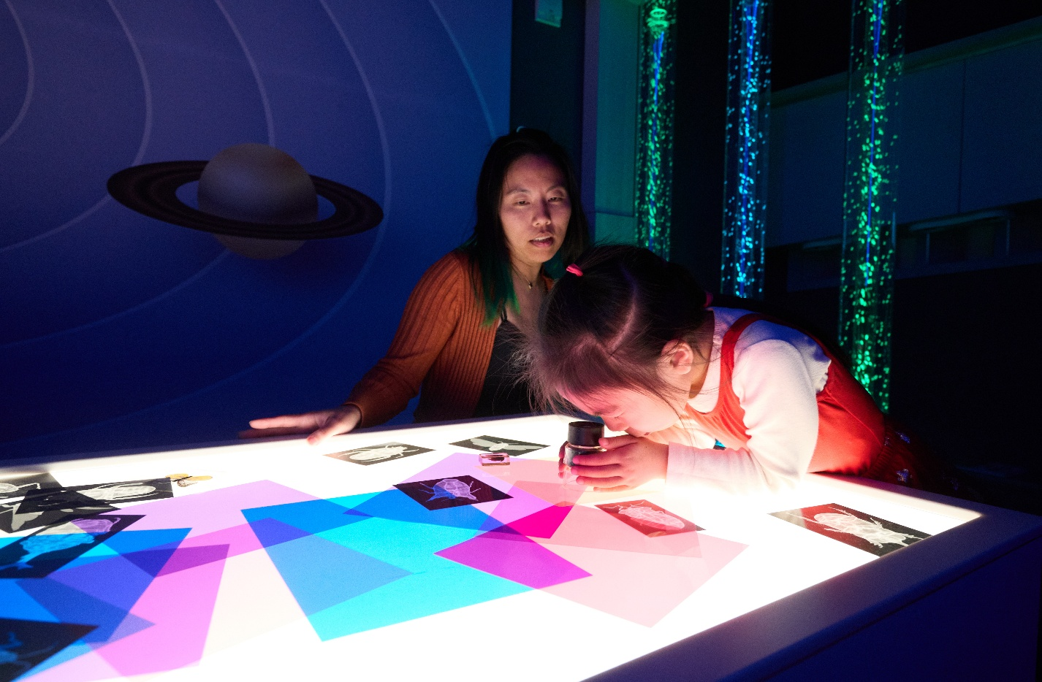
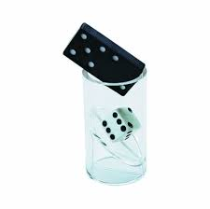

https://www.seattlechildrens.org/health-safety/injury-prevention/toy-safety/
CITY OF RANCHO CUCAMONGA

Slide 7



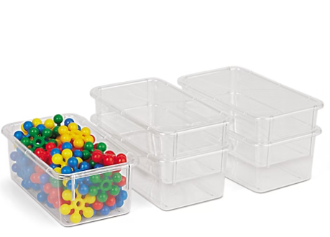
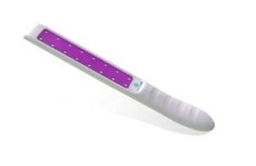

Slide 8
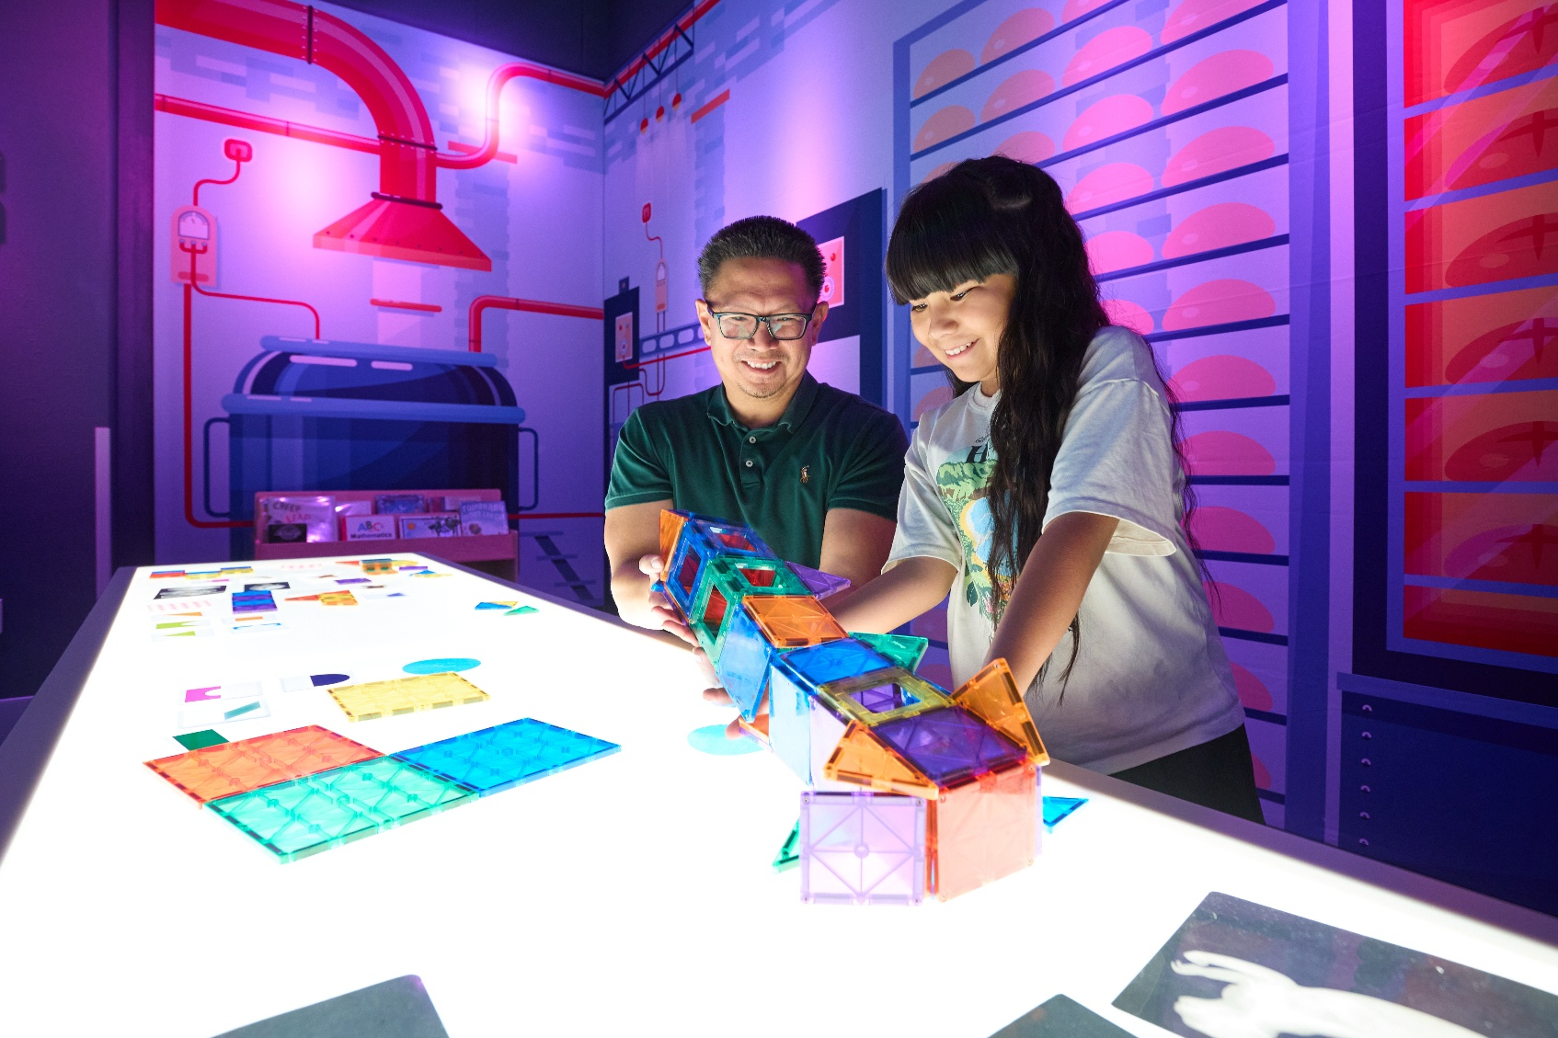
Thank you!
CITY OF RANCHO CUCAMONGA

Slide 9

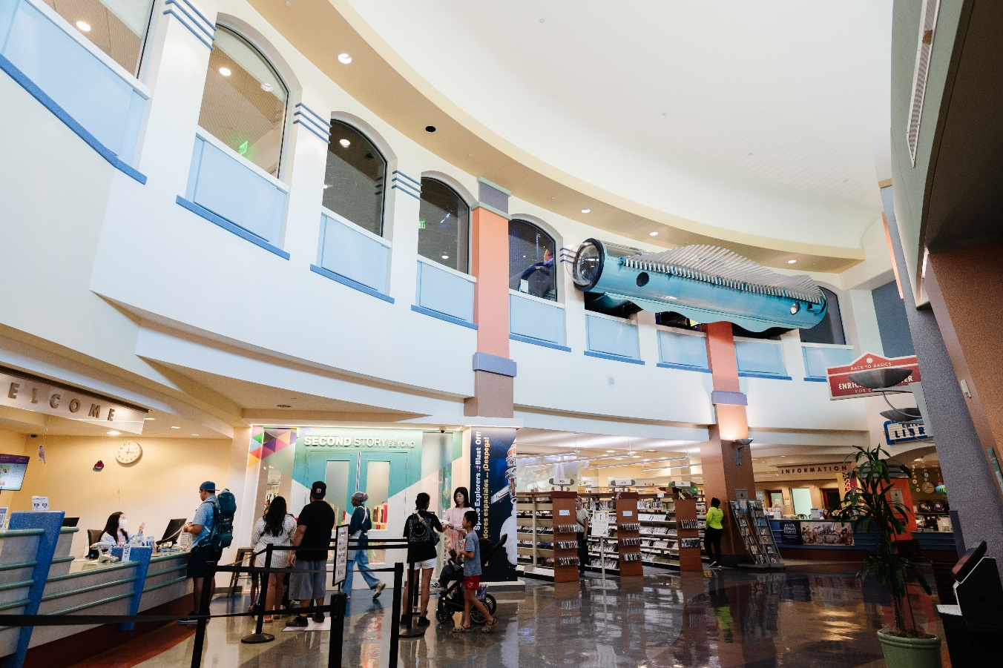
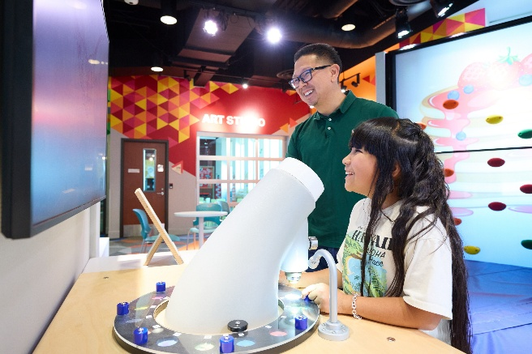
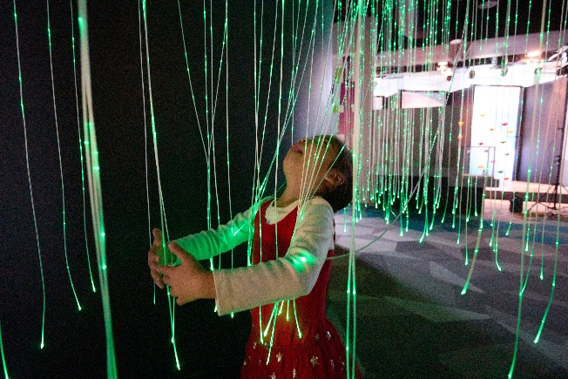
Wess Garcia, Library Director
Rancho Cucamonga Public Library
909-774-3973
Wess.Garcia@CityofRC.us
CITY OF RANCHO CUCAMONGA

