Slide 1
2025/26 EmPOWERing Access
California State Library
Southern California Library Cooperative
This project is supported in whole or in part by the U.S. Institute of Museum and Library Services under the provisions of the Library Services and Technology Act, administered in California by the State Librarian.

Slide 2


Introductions
Chris Durr, Library Programs Consultant
Nerissa Snodgrass, Project Manager
Christine Powers, Executive Director

Slide 3
Background
This project will offer Libraries the ability to request ADA-accessible privacy booths, Charlie carts, book bikes, family workstations, light tables, and sewing machines.
This project will encourage library users to connect with community resources and provide new ways to access information and learn new skills.
Priority will be given to libraries with underserved communities, including those with high rates of poverty, as measured by the California Poverty Measure.

Slide 4

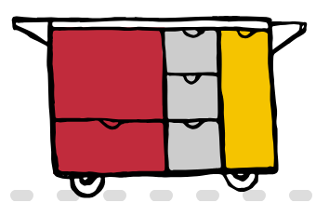

Introductions
Brian Johnson, Executive Vice President
Pillar Booths
Michelle Derheim, Director Customer Engagement
Siobahn Keys, Senior Administrative Assistant
The Charlie Cart Project
Stephen Horcha, Founder/Owner
Hayley Tricycles

Slide 5
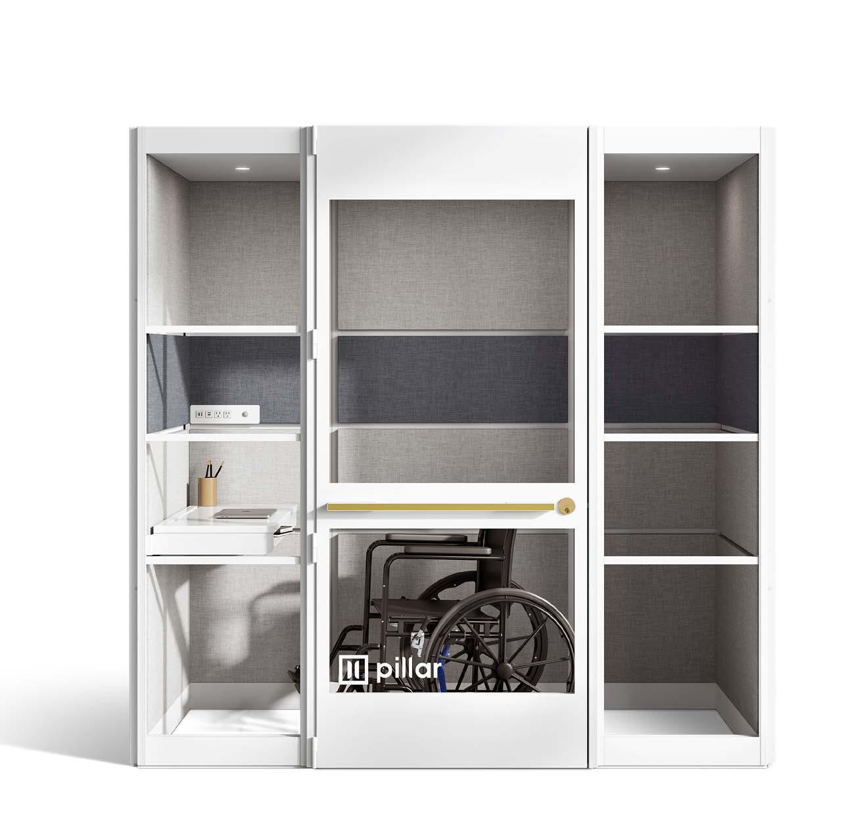
Pillar Accessible Privacy Booths
For use by patrons for telehealth appointments, job interviews, legal appointments, educational sessions, or any other virtual connection that requires privacy.
Booths are ADA-compliant and energy efficient, with automatic sensors, and run on as much power as a hair dryer.
Colors/materials as shown, and will include connections for a computer (i.e. arm).

Slide 6
Application Process
Online application through SCLC
EmPOWERing Access – Project Application (FY 2025/26) Survey

Slide 7
Project Timeline
Applications due by Friday, February 6, at 12:00 pm
SCLC will place orders in March 2026
All items will be shipped by end of May

Slide 8
Questions
Nerissa Snodgrass Project Manager, SCLC
nsnodgrass@socallibraries.org

